Slide 1
Module 9: Maps in React
SER 423

Slide 2
Overview
Last time we talked about how both Android and iOS handle location and maps
Our focus now is on how react abstracts those methods to create a bridge that works for both platforms
  There are no platform specific flags or anything
We will still need to setup permission to use location data
But this time we can do it within our code itself instead of a setting type of file
These operations, both getting permission and getting the location, are done asynchronously
The location call may require a network call which is why it needs to be asynchronous
The permissions call might seem an odd choice to make asynchronous, but because we are doing it at run time we need to make a request and the device needs to process it
  As always, we don’t want to hang the UI waiting

Slide 3
The Setup
We should request location permission as soon as we can, so we do this within componentDidMount
We can use the expo Permissions package to make our request
  We need to use Permissions.LOCATION
The response to this request will have a status variable we can check to see if the request was successful
If the status is “granted” we can proceed
We can then use the expo Location package to find the location
Once we have it we can store it in state
By putting this in componentDidMount the location will update every time that it mounts
  We would have to move this if we want more real time updates

Slide 4
Looking at the Location and Map Itself
The location object will have several properties you can use
Of particular interest to us is the coords property
This itself has both a latitude and longitude property
The map will take these properties in order to know where to display the initial region
  It will also take a delta for both of these properties to define how far zoomed in it is
The map itself is a MapView
The MapView takes an initial region property which is the above latitude and longitude information
To display a particular spot on the map, we use a Marker
Within our MapView we can define a MapView.Marker element
This takes a coordinate property, a title to display, a description to show, and an image

Slide 5
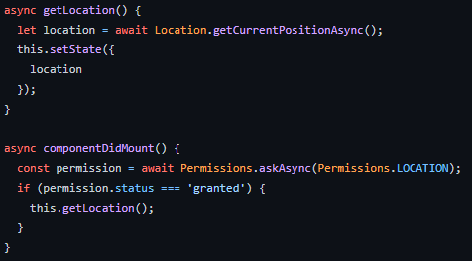
Permissions and Location Polling

Slide 6
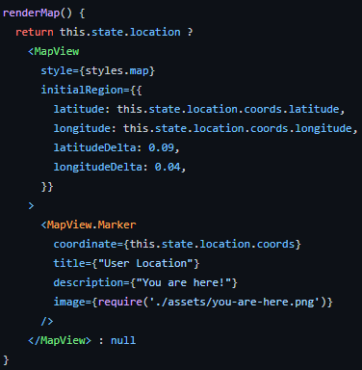
Rendering the Map and a Marker

Slide 7
That’s it for Maps in React
That’s it for Module 9!

